Slide 1
IB Chemistry Higher Level Introduction
Wilt Gu

Slide 2
Self-introduction
Wilt 顧思偉
Teaching in PH 10.5 yrs
IB Chemistry & Biology & ESS teacher
IB Biology Examiner
Chemistry Competition Coach
Huskies Assistant Coach
Voice of Pinghe Mentor
Tel/WeChat: 13701718422
Office: Room 305
Email: gusiwei@shphschool.com

Slide 3


Slide 4


Slide 5
Syllabus outline
Core for both SL & HL: 110 hr
Additional Higher Level (AHL): 70 hr
Collabrative Sciences Project: 10 hr for both SL & HL
Practical Work: 20 hr for SL, 40 hr for HL
Scientific Investigation: 10 hr for both SL and HL
Total teaching hours: 150 hr for SL, 240 hr for HL

Slide 6
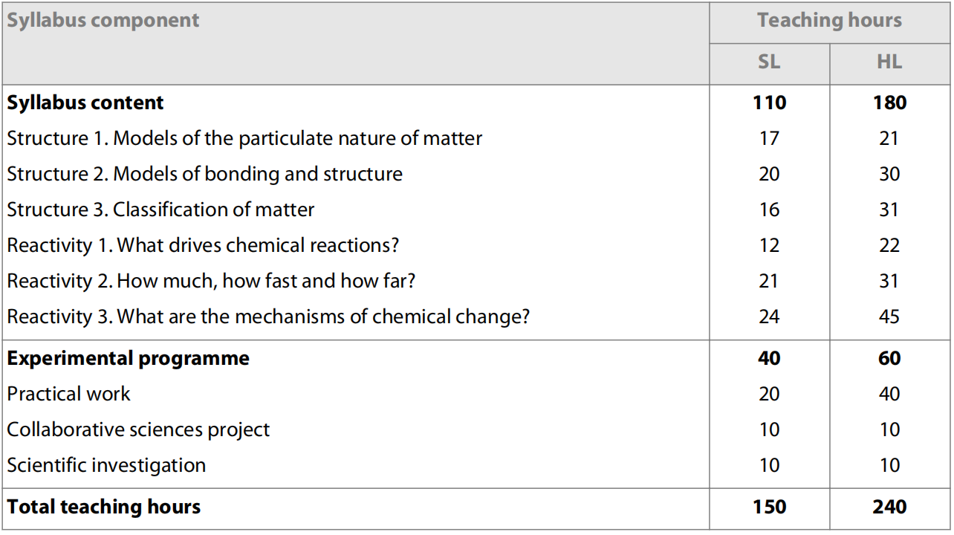
Syllabus Contents

Slide 7
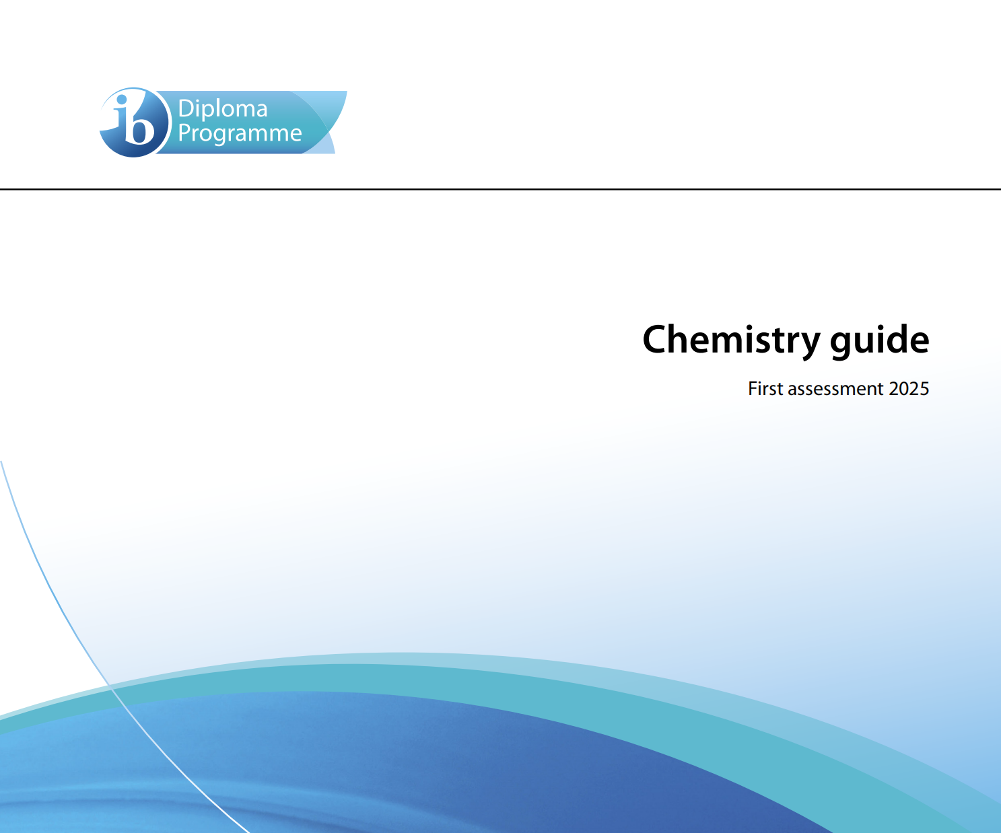
Use the chemistry guide
Available on MB
It provides all the information shown today
Detailed syllabus P33
Glossary of command terms (used in exam questions) P81

Slide 8
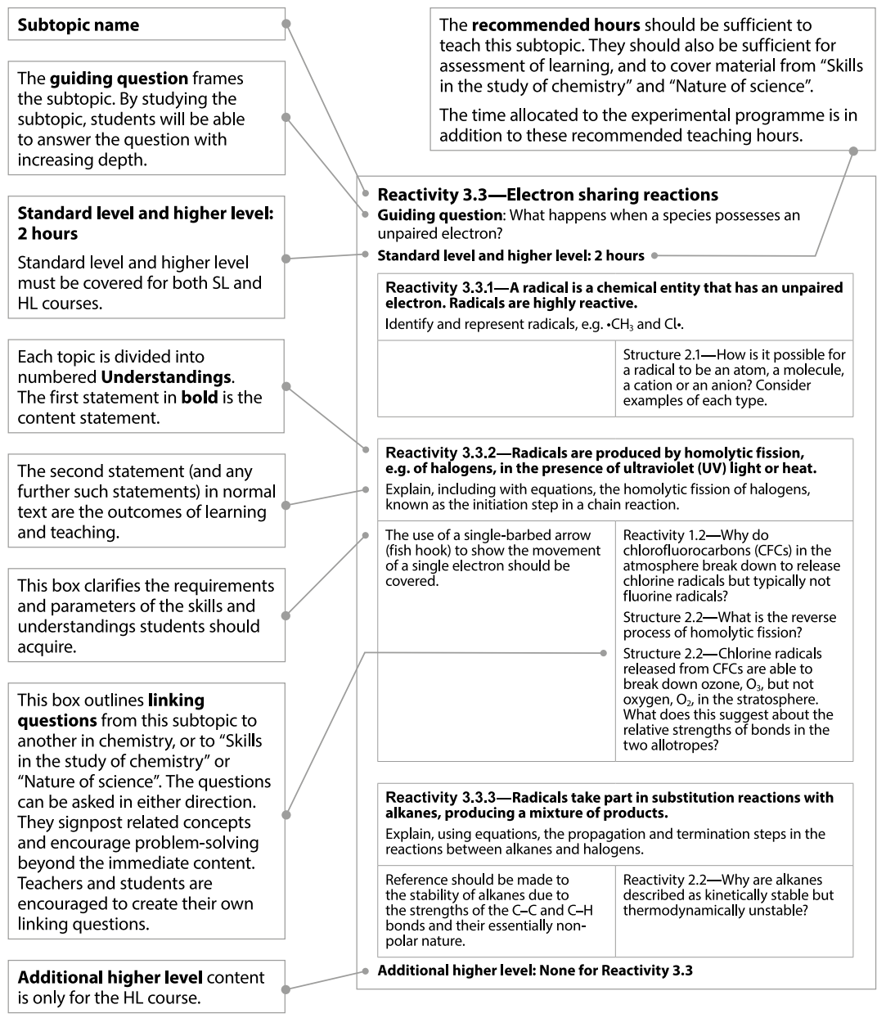

Slide 9
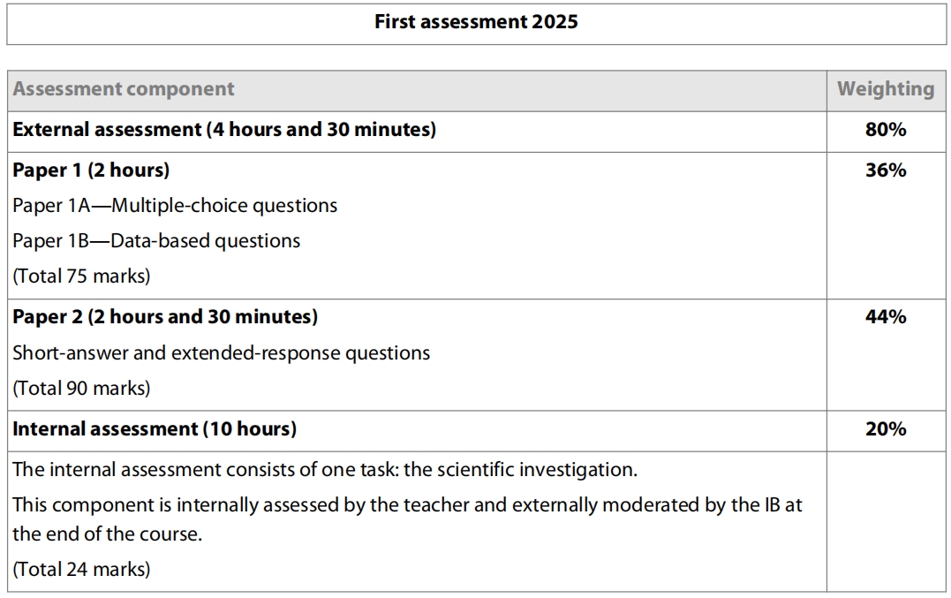
Assessment outline: HL

Slide 10
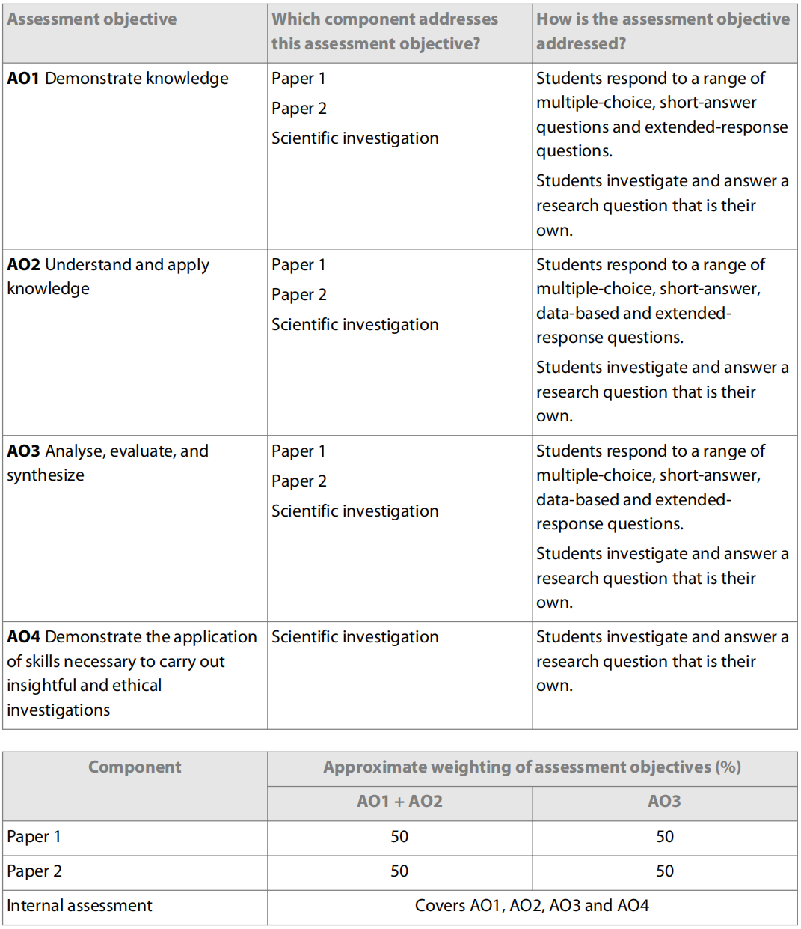

Slide 11
The scientific investigation
Duration: 10 hours Weighting: 20%
The IA requirement is the same for biology, chemistry and physics. The IA, worth 20% of the final assessment, consists of one task—the scientific investigation.
The scientific investigation is an open-ended task in which the student gathers and analyses data in order to answer their own formulated research question.
The outcome of the scientific investigation will be assessed through the form of a written report. The maximum overall word count for the report is 3,000 words.
The following are not included in the word count:
Charts and diagrams, Data tables, Equations, formulas and calculations, Citations/references (whether parenthetical, numbered, footnotes or endnotes), Bibliography, Headers
The following details should be stated at the start of the report.
Title of the investigation, IB candidate code (alphanumeric, for example, xyz123), IB candidate code for all group members (if applicable), Number of words
There is no requirement to include a cover page or a contents page.

Slide 12
Facilitating the scientific investigation
The research question should be of interest to the student, but it is not necessary that it encompasses concepts beyond those described by the understandings within the guide.
The scientific investigation undertaken must have sufficient extent and depth to allow for all the descriptors of the assessment criteria to be meaningfully addressed.
The investigation of the research question must involve the collection and analysis of quantitative data that should be supported by qualitative observations where appropriate.
The scientific investigation allows a wide range of techniques for data gathering and analysis to be employed. The approaches that could be used in isolation or in conjunction with each other are as follows.
Hands-on practical laboratory workInternal assessment
Fieldwork
Use of a spreadsheet for analysis and modelling
Extraction and analysis of data from a database
Use of a simulation
The Chemistry teacher support material contains further guidance on these possible approaches.

Slide 13
Developing and implementing the research question
Each student is expected to formulate, investigate and answer a unique research question, seeking advice from their teacher.
A student must not present the same set of raw data as another student.
Each student develops their own methodology to answer their individual research question. The student investigates by:
manipulating an independent variable
or
selecting variables during fieldwork
or
selecting different data from external databases.
The student might seek support from peers when collecting data.

Slide 14
Methodology for collaborative work
Collaborative work is optional and where it is facilitated the groups formed must be no larger than three students. Students may organize their own groups. The teacher must provide guidance to ensure that all students are fully engaged in the collaborative activity. Students must clearly understand the requirement to conduct an individual investigation.
The methodology developed to answer their individual research question may be in part the outcome of collaborative activity. A student within the group investigates their individual research question by manipulating:
a different independent variable from those selected by other group members
or
the same independent variable with a different dependent variable from those selected by other group members
or
different data from those selected by other group members from within a larger communally acquired data set.
In this context, collaborative work is permitted under the understanding that the final report presented for assessment is that of the individual student. A report by the group is not permitted. All authoring, including the description of the methodology, must be done individually. This diagram illustrates a possible route through the IA process where students collaborate.

Slide 15
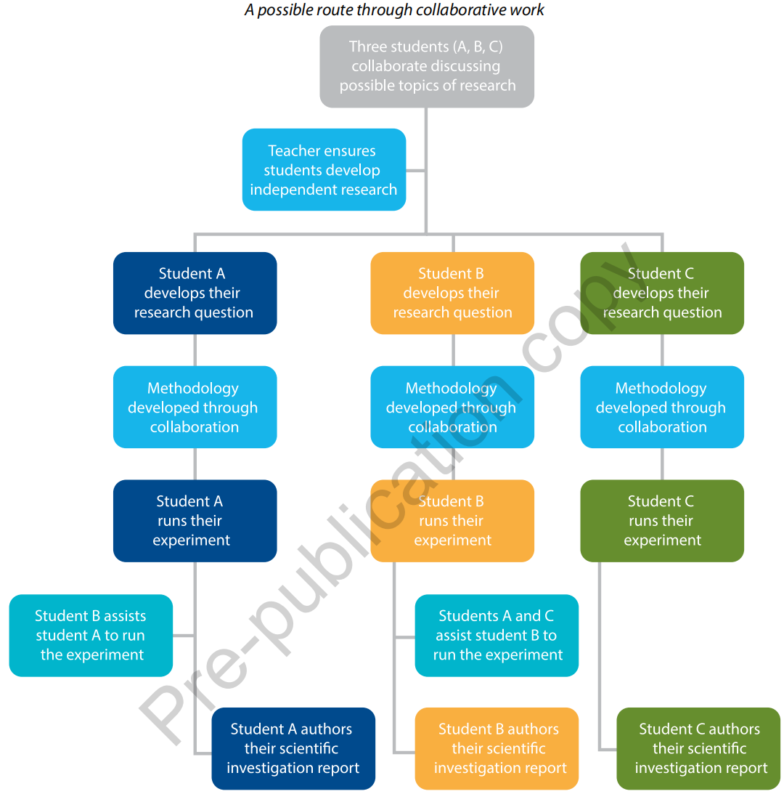

Slide 16
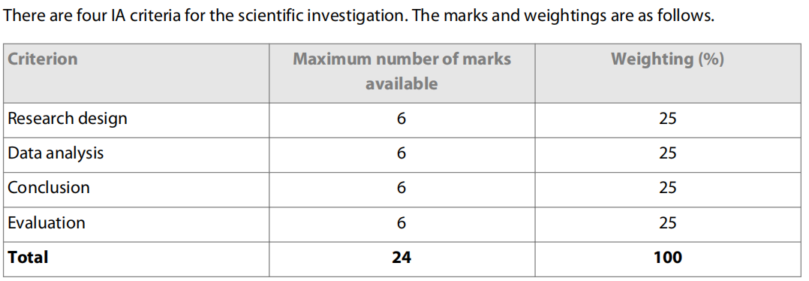
Internal assessment details

Slide 17
Group 4 Project
10 hours
Assessed in IB year 1 (Y11) second semester
three stages: planning, action and evaluation.
mixed-subject groups and one topic
School may adopt mixed-subject groups and choose one common topic. The number of groups will depend on the number of students.

Slide 18
Additional resources (Not compulsory, available on MB)
Additional Exercises for each chapter (Core & AHL separately)
Fast Facts for each chapter (summary of each chapter, you may review it before doing your exercises, tests, and exams)
Periodic tables (both simple one and extremely detailed one, for different use)
Exercises and Books about A-Level & AP Chemistry
Lange’s Chemistry Handbook (perfect for doing data-based IA)
etc.

Slide 19

Academic honesty
Be authentic !!!
Any suspicious work submitted involving academic honesty issue will be penalized by giving a mark of zero.
will be used for originality checking.

Slide 20
School Assessment
1st Monthly Test: 15%
Mid-term Exam: 20%
3rd Monthly Test:15%
Final Exam: 30%
Coursework: 15%
Experimental Practical Work (IA): 5%
(the percentage of the last two parts will change in the next semesters)

Slide 21
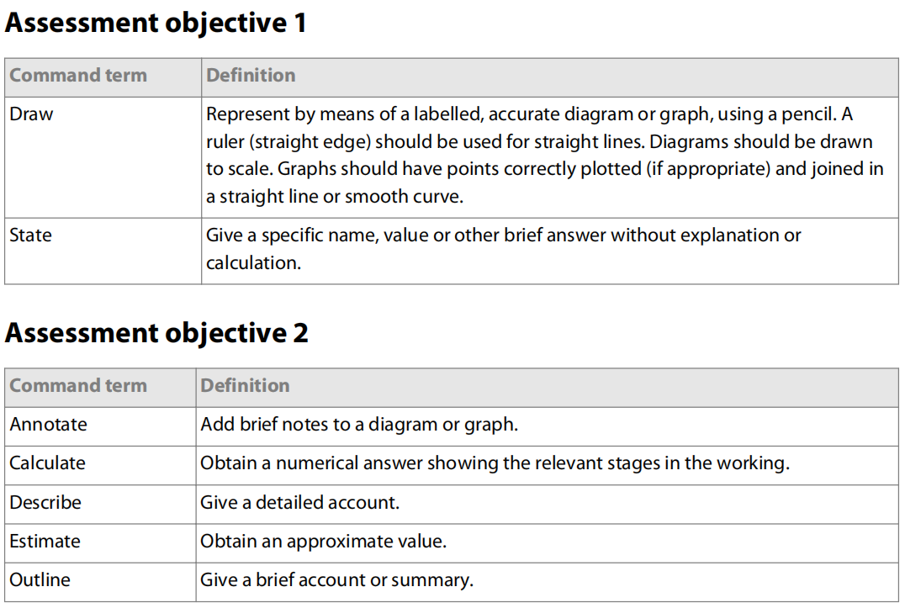
Command Terms of Chemistry

Slide 22
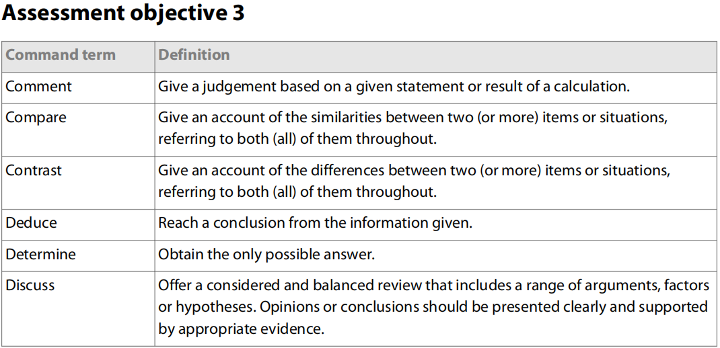
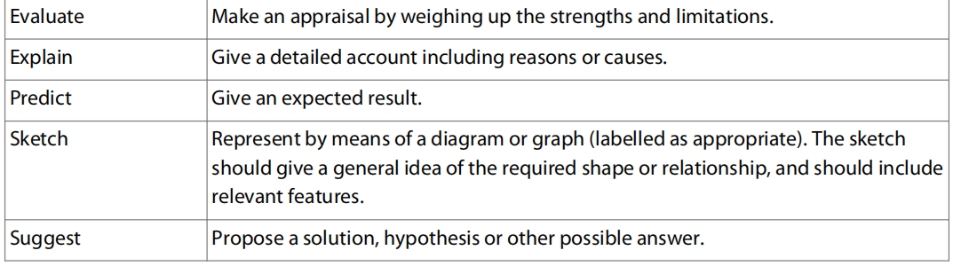

Slide 23
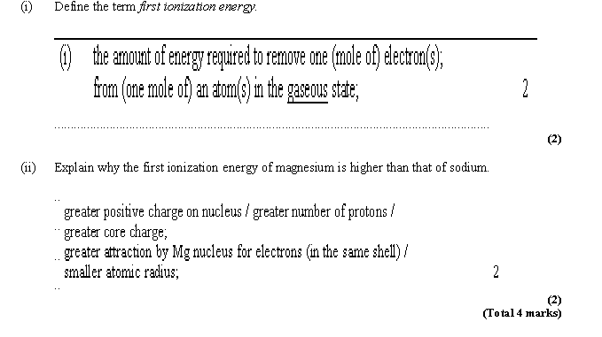

Slide 24
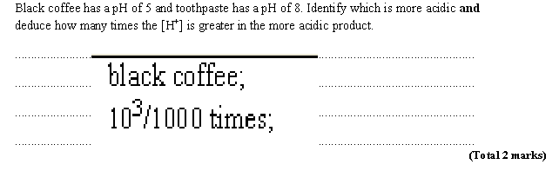

Slide 25
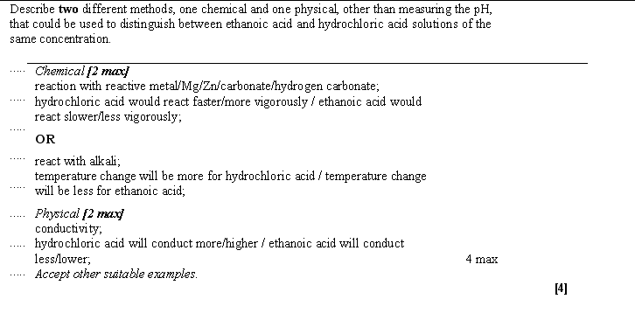

Slide 26
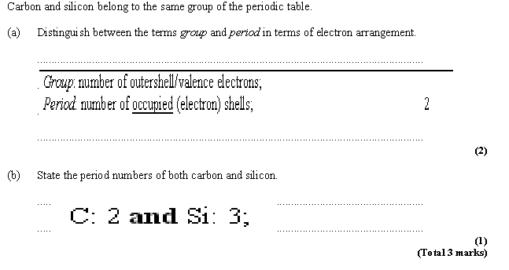

Slide 27
